Slide 1
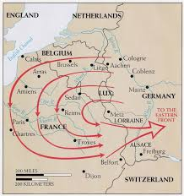
Cleeve Prior 1914 -1918
Notes:
What triggers British involvement involvement is the enactment of The Schlieffen Plan…Fr & Ru long standing allies and any war with one would lead to both being involved. Head of GG staff VS devised plan in 1897 to take Fr out of War before Eastern Front could develop. Von Moltke who replaced the ageing VS in 1906. The original plan involving 90% of G troops and sweeping through Holland as well as Belgium may well have been successful by shear weight of numbers alone but VM watered it down somewhat and in essence it was flawed as it was based on four basic assumptions.
Belgium troops would not defend their country. 2. Britain would not come to Belgium’s aid. 3. France would be defeated in 6 weeks. 4 It would take Russia 6 weeks to mobilise.
Germany invades Belgium on the 2nd August.

Slide 2
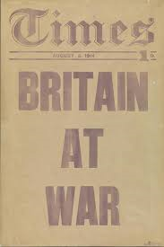
Cleeve Prior 1914 -1918
Notes:
Britain had guaranteed Belgium’s neutrality in an agreement dating back to 1839 in what the German ambassador describes as a ‘scrap of paper’ Our demands that the German troops leave Belgium immediately were ignored and so we DW on the 4th August. Within 4 days 100,000 men of the BEF had landed in France and moved forward into Belgium to meet the German Army

Slide 3
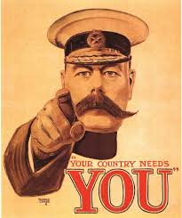
Cleeve Prior 1914 -1918
Notes:
Britain as an island had always relied on the Navy for defence of these shores and as a result had a miniscule against the other participants although it was a professional army…Germany at this point had mobilised 3 million men and France about 2 million. The need for replacement troops was paramount and a recruitment drive was put in place within days in all countries.
In Britain we had the Lord Kitchener poster which came in various guises From a marketing point of view it was brilliant …with eyes staring and finger pointing there was no doubt that he was calling on YOU !
The 1914 poster was actually a Union Jack

Slide 4
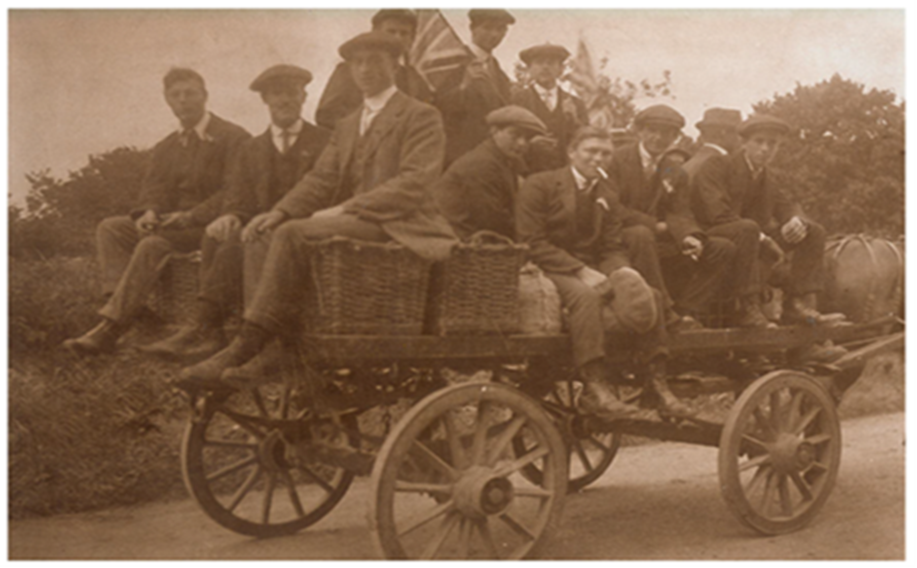
Cleeve Prior 1914 -1918
Notes:
A photograph showing some of the CP men off to enlist at Evesham within days of the outbreak of war……. off no doubt in their eyes to ’bag a few hun’ before the show was over !

Slide 5
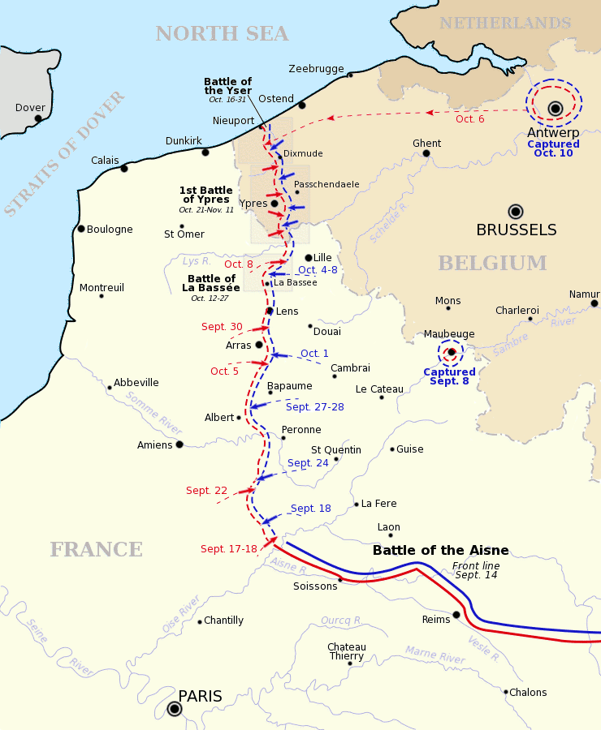
Cleeve Prior 1914 -1918
Notes:
22nd August the BEF meet German 1st Army at Mons and despite inflicting heavy losses they are soon doing a tactical withdrawal following the collapse of the French 5th Army which exposes their right flank. The tactical withdrawal rapidly becomes a full blooded retreat due to sheer weight of numbers. The troops retreated 20 miles plus a mostly on foot for nearly two weeks before on the outskirts of Paris on the 7th September it counter attacked in concert with the French forces in what became known as the Battle of the Marne. The Germans had by then over extended their supply lines and fell back to the River Aisne where they held the high ground. Stalemate ensued and they decided to try and outflank the British and French troops in what became known as the ‘Race to the Sea’ in a bid to cut off supply to the British Army via Calais and Dunkirk. Their followed several leap frogging actions as the front line headed northwards and the Belgian King decides to open the seagates at Nieuport in order to flood the Polder or reclaimed land and reduce the length of the front line.

Slide 6
Cleeve Prior 1914 -1918
Notes:
The sea gates as they are seen today which allows the water from the land that is below sea level to be drained at low tide. The effect of opening the sea gates did not cause an instant flooding effect on the landscape but rather a slow deterioration There was extremely heavy fighting by the Belgium army along the coastal route to defend the Channel Ports and they fought with incredible tenacity. It took a couple of weeks for the Germans to realise what had happened and initially had thought the ground was getting wetter with the onset of winter…...This forced them to re-direct their effort at Ypres which was on high ground as their access through to the Channel ports……. Next slide Eventually the land succumbed ….

Slide 7
Cleeve Prior 1914 -1918
Notes:
Eventually the land succumbed and the effect of this was to severely flood the Yser valley all the way up to Ypres a distance of some 25 miles and thus shorten the defensive line. ( This picture is from a postcard ) With high explosive shells destroying what drainage systems were in place even non flooded ground soon became a boggy and sodden morass……. Next slide

Slide 8
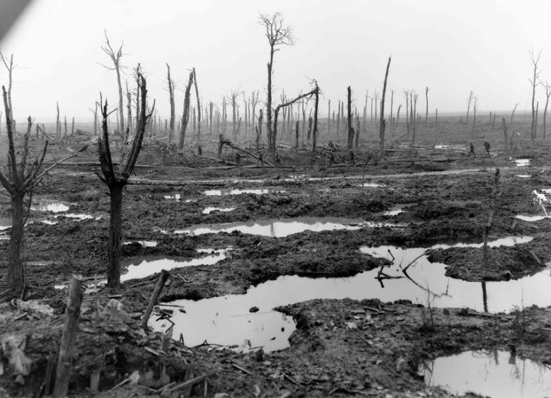
Cleeve Prior 1914 -1918
Notes:
With high explosive shells destroying what drainage systems were in place even what remains of this wood which was above sea level becomes an almost impenetrable barrier.
The German Army faced with this terrain re direct their army toward the pivotal town of Ypres, and it is here we lose the first of our Cleeve prior men….and this is…..next slide

Slide 9
Harry Arthur Nicholls Born March 1895 Parents Frederick & Fanny Nicholls of Marlcliffe Private S/No 12878 Worcs 2nd Battalion
Cleeve Prior 1914 -1918
Notes:
Harry Nicholls was a career soldier and went over with the BEF to Belgium in the second week of August, by the end of October the second Worcs battalion once around 1000 strong was now numbering 370 men.

Slide 10
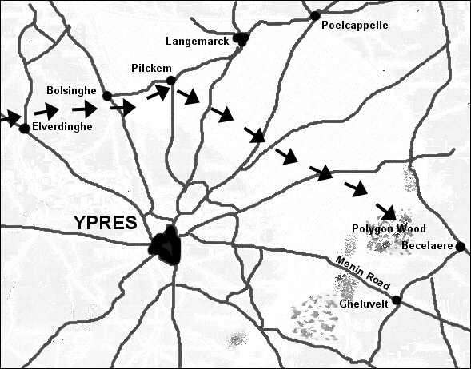
Cleeve Prior 1914 -1918
Notes:
They were being held in reserve in Polygon Wood to cover the Gheluvelt sector which is to the East of Ypres. The Germans with superiority of numbers manage to breach the front line at Gheluvelt village and Chateau….next slide

Slide 11
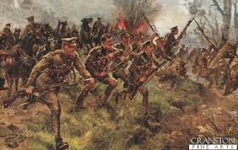
Cleeve Prior 1914 -1918
Notes:
Worcestershire 2nd Btn attack Gheluvelt Chateau at the double in order to get over the exposed ground as quickly as possible but in the process lost another 100 men either killed or wounded by high explosive or shrapnel shells and more men were lost in the ensuing hand to hand fighting. They charged into the somewhat surprised German troops and after a fierce struggle put them to flight, they then managed to link up with the South Wales Borderers to their right and the Scots Guards to their left and the front line was secured….. next slide

Slide 12
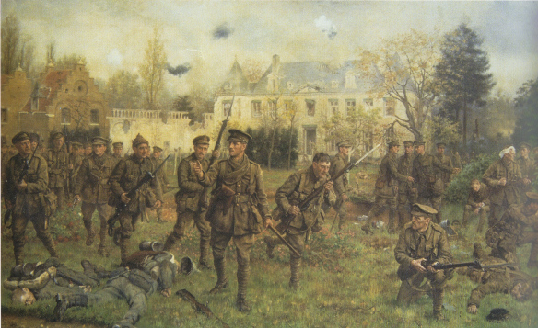
Cleeve Prior 1914 -1918
Notes:
In closing the line against terrific odds the 2nd Worcestershires came in for special praise from the British commander in Chief Sir John French…… The British papers were full of praise for the gallantry of the men and the headlines read ‘Worcestershires Save the Empire’ Out of the 370 men who carried out the attack a further 192 were casualties of which Harry Nicholls was one. He was severely injured in the attack and taken back to Poperinge where he subsequently died of his wounds on the 2nd November 1914

Slide 13
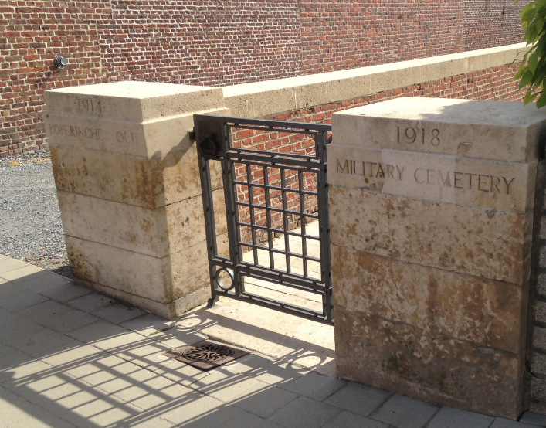
Poperinge Old Military Cemetery
Cleeve Prior 1914 -1918
Notes:
He is buried at the Poperinge Old Miltary Cemetery in the middle of the town

Slide 14
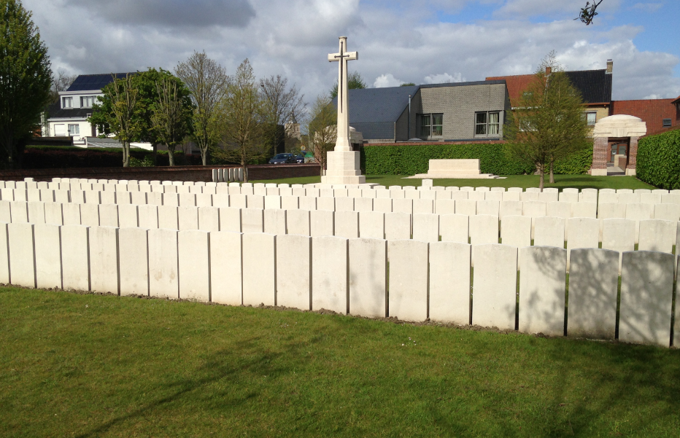
Cleeve Prior 1914 -1918
Notes:
This is the cemetery……and this is harry Nicholls grave

Slide 15
Cleeve Prior 1914 -1918
Notes:
Read out inscription. 12878 Private A.H.Nicholls Worcestershire Regiment 2nd November 1914 Age 19……… Following on from the action at Gheluvelt the front line is stabilised around Ypres and with the onset of winter the troops of both sides dig in for the start of what was to become a 4 year attritional war.
The British lost in this period of time about 80% of the old professional army that went over in August and for the French an astonishing 2200 men were being lost every in the defence of their homeland

Slide 16
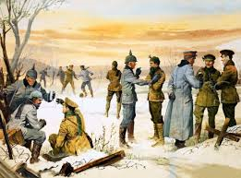
Cleeve Prior 1914 -1918
Notes:
ends with the infamous Christmas truce. A lot has been written about this and certainly in many parts of the line carols were sung with terrrific gusto by both sides and in particular the silent night / stiehle nacht carol which was familiar to both sides. Truces were held both on Christmas and Boxing days in certain sections in order to bury the dead and to retrieve bodies from No Mans Land which would have a caused a certain amount of integration, exchanging cigarettes and showing pictures of girl friends and wives would have certainly taken place. However these events did not take place all over the front and the scene depicted in the slide with the smartly dressed officers having a convivial chat over a swig of brandy and schnapps with the lads playing footie in the background certainly did not occur.
The high command of both sides went ballistic when they found out about these unofficial truces and forbade anything like this happening again.

Slide 17
1915
Cleeve Prior 1914 -1918
Notes:
Spring of 1915 sees the Germans move significant manpower to the Eastern Front in a bid to remove Russia from the War and are prepared to hold on to the ground taken in the West. Both the British and French go on the offensive but with manpower and munitions still in short supply nothing significant can be achieved. It is only by the Autumn that they are both in a position to mount an offensive on a wide front with the British attacking at Loos and the French in the Artois region. It was in the Battle of Loos which commenced on September 15th in the first of our so called ‘Big Pushes’ that we lose another two Cleeve Prior men.

Slide 18
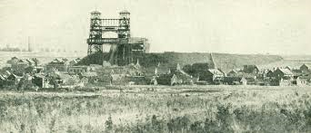
Cleeve Prior 1914 -1918
Notes:
The Loos area was a coal mining area full of spoil and slag heaps. It was not an ideal fighting ground and was dominated by these two pit head towers which the Germans used for observation towers and ….next slide two immense slag heaps etc

Slide 19
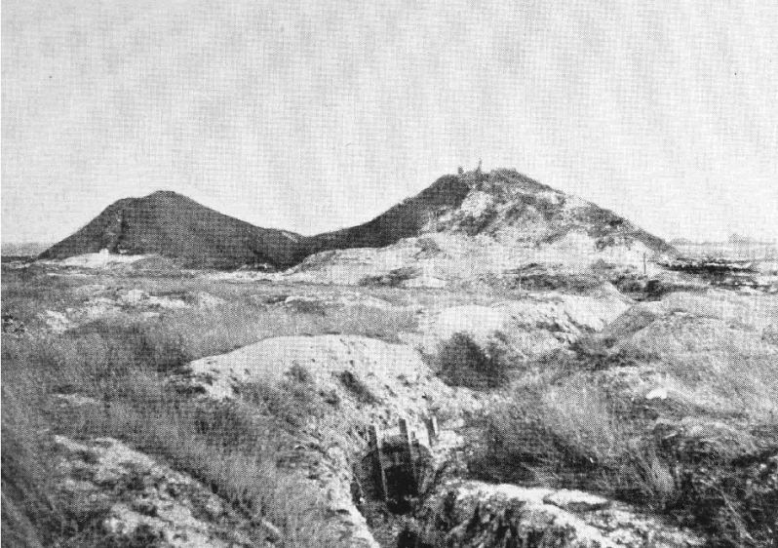
Cleeve Prior 1914 -1918
Notes:
…………….. by two immense slag heaps that rose to a height of about 450ft and can be seen from miles around, needless to say these were heavily fortified by the Germans but if any breakthrough were to succeed these had to be taken. This photograph was taken after the war and significantly lower after being shelled for a couple of years…..next slide

Slide 20
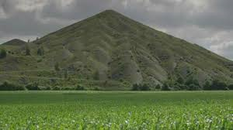
Cleeve Prior 1914 -1918
Notes:
This is how they are today at a height of 520 feet Mining continued after the war until 1986 when they were shutdown

Slide 21
James William Spiers Born in Evesham 1894 Parents William & Elizabeth Spiers of Evesham Private S/No 12606 Worcs 1st Battalion
Cleeve Prior 1914 -1918
Notes:
Our 2nd man who lost his life is……. I have been unable to find out the exact circumstances of his death on the opening day of the Battle of Loos due to the casualty figures being so high but the B of L is noteworthy for the first time the British used poison gas…..next slide

Slide 22
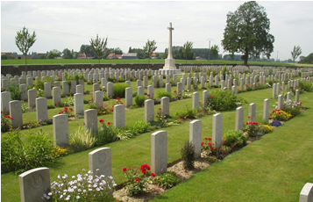
Cleeve Prior 1914 -1918
Notes:
I have been unable to find out exactly where or how he was killed but this is where James Spiers is buried.….The Ration Farm Military Cemetery at Chappelle Armentieres…..next slide

Slide 23
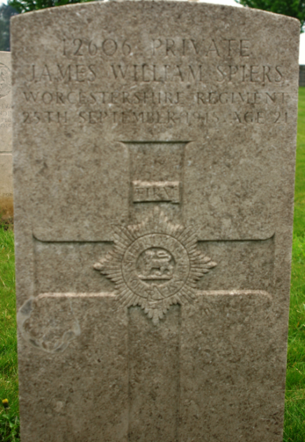
Cleeve Prior 1914 -1918
Notes:
His grave is the in front row and second from the right James William Spiers who died on the 25th September 1915 aged 21

Slide 24
Harry James Haywood Born in Cleeve Prior 1896 Son of Mrs Sarah Haywood of Cleeve Prior Private S/No 17271 Worcs 2nd Battalion
Cleeve Prior 1914 -1918
Notes:
Our third man in the village was killed at the same battle almost 7 weeks later is….. Henry James Haywood…

Slide 25
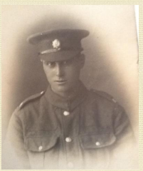
Cleeve Prior 1914 -1918
Notes:
Picture of Harry Haywood in his army uniform. Harry Haywood was killed with several other men when a large German mine was detonated under the section of front line trench that they were manning. The explosion buried several men with others on the surface part buried or simply dazed by the concussion. The Germans lit up the area with a searchlight and continued to machine gun the resultant crater and surrounds….next slide

Slide 26
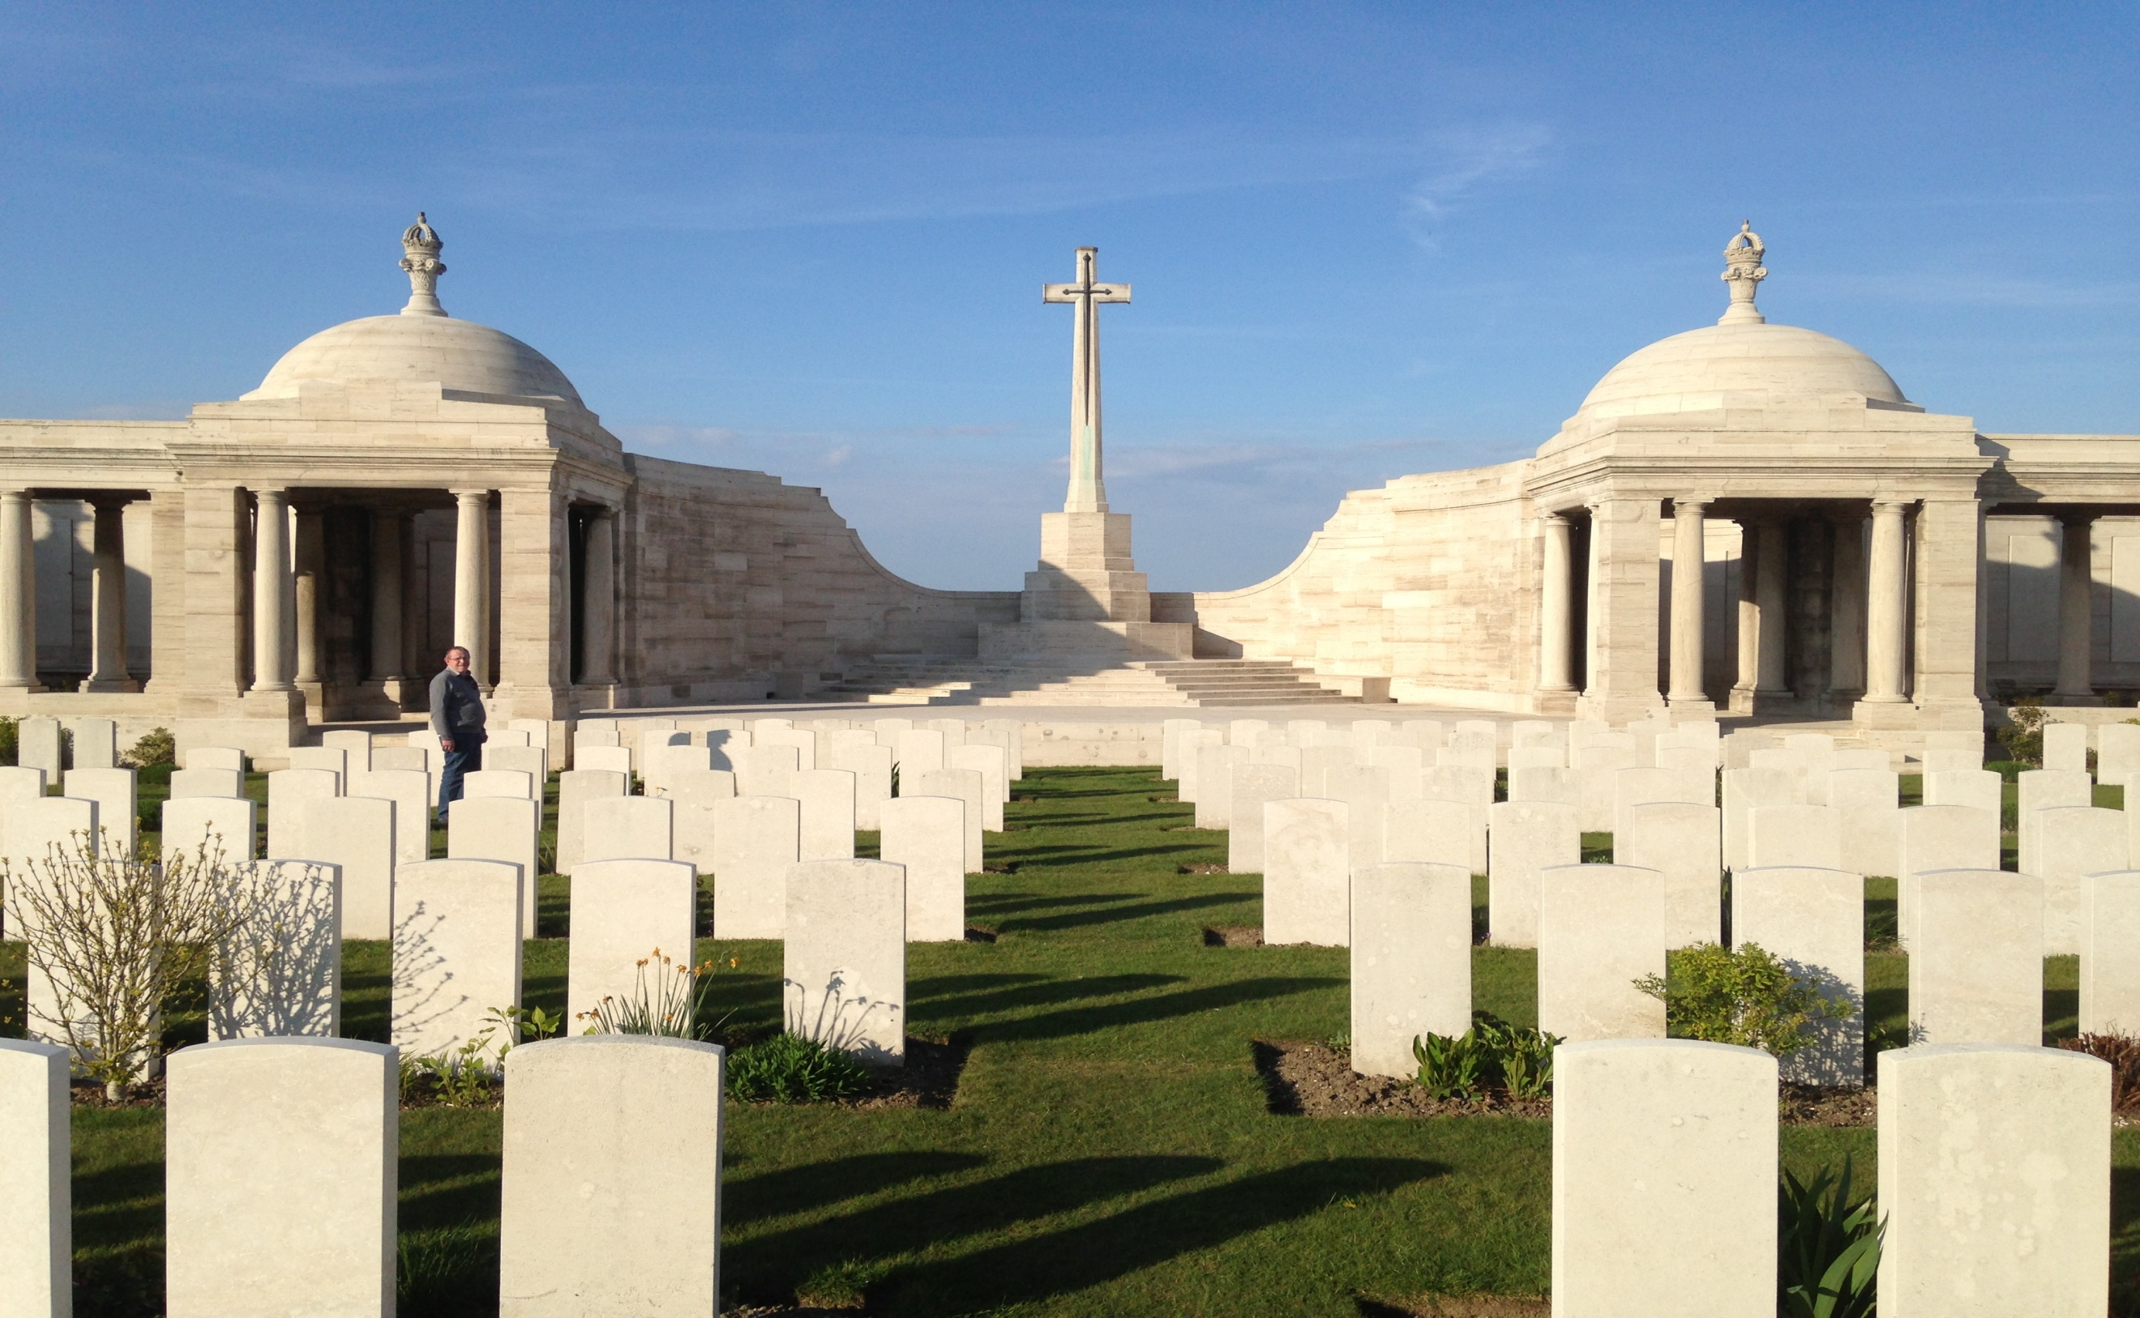
Cleeve Prior 1914 -1918
Notes:
Henry James Haywood’s body was never found and he is commemorated here at the Loos Memorial to the missing at the Dud Corner Cemetery.

Slide 27
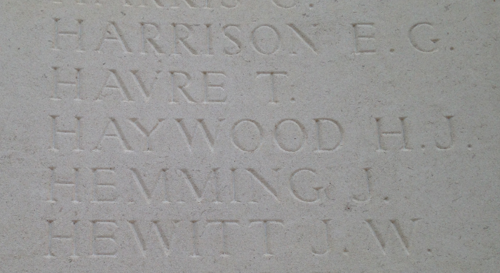
Cleeve Prior 1914 -1918
Notes:
Henry James Haywood died age 19 on the 10th November 1915 For those who maybe not aware Haywood ……just off the Close in CP is named after him.

Slide 28
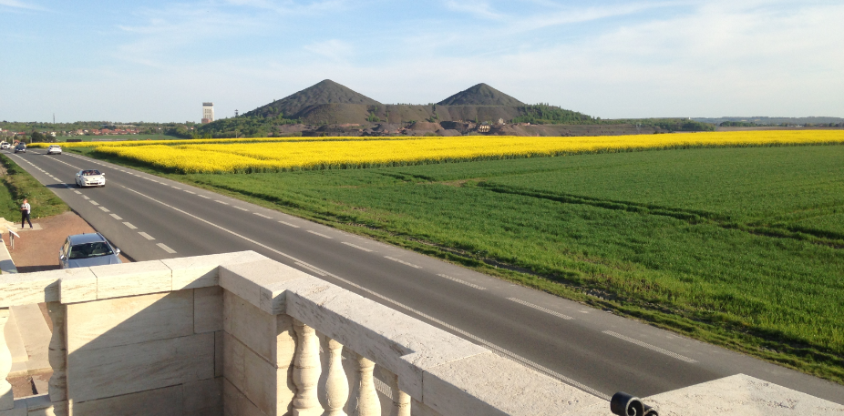
Cleeve Prior 1914 -1918
Notes:
This is the view from the cemetery looking out toward the slag heaps…next slide

Slide 29
Cleeve Prior 1914 -1918
Notes:
And a reminder as to how it appeared after the war. The result of the B of L is that after good initial gains the initiative was lost by the reserve troops being held too far back and that there was a general lack of artillery support due to shortages of shells. The Germans counter attack after the British attack fizzles out and retake their earlier overrun trenches. The nett result after two months fighting in terms of loss of men is a further 50,000 British men killed to the Germans 25,000. Nothing is gained in terms of territory and after this major battle things wind down again for the winter.

Slide 30
1916
Cleeve Prior 1914 -1918
Notes:
February 1916 sees the German army start their attack around Verdun in an attempt and I quote ‘to bleed the French Army white’ and this battle continues to be fought with over a million men on either side for another eight months until mid December. Estimates on casualty figures of dead and wounded are nearly half a million men for the French and 350,000 for the Germans ……In order to draw German troops away from Verdun the British together with the French launch their own offensive at the Somme with disastrous results…..after days of shelling the men went over the top on July 1st in what proved to be the worst day in the British Armies long history with 57,740 casualties. The battle continues until November 18th and proved to be the most costly of the First World War with combined casualty figures of over a million men with the British figures standing at 420,000
Rather surprisingly given these numbers the village suffers no more loss of life in 1916…...next slide 1917

Slide 31
1917
Cleeve Prior 1914 -1918
Notes:
The War for a brief moment comes back to Blighty with the loss of our 4th man on the 17th January 1917 and this is……Raymond Wilfred Stanley….. next slide

Slide 32
Raymond Wilfred Stanley Born in Walsall 12th Jan 1891 Parents Isaac & Annie Stanley of Cleeve Prior Pilot Royal Flying Corps S/No 43126
Cleeve Prior 1914 -1918
Notes:
Read out slide….next slide

Slide 33
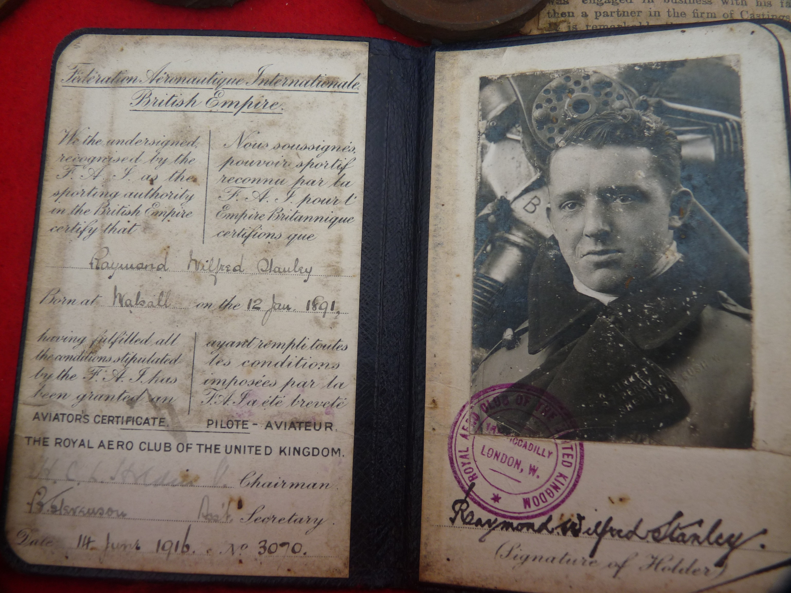
Cleeve Prior 1914 -1918
Notes:
This is a picture or Raymond Wilfred Stanley in his Aviators Licence dated 14th June. To obtain this license you had to prove in two figure of eight flights over a minimum distance of 3 miles 185 yards that you were capable of attaining a height of 100 feet and then land the plane within 50 yards of touchdown. It must have been the good old health and safety boys who insisted that it was two flights not one I suspect ! He subsequently joined the Royal Flying Corps and underwent his military flying training at Hounslow Aerodrome…..next slide

Slide 34
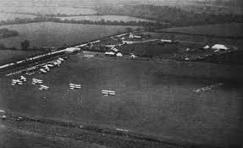
Cleeve Prior 1914 -1918
Notes:
This is a picture of Hounslow Aerodrome 1916 with a grass landing strip and a couple of huts.

Slide 35
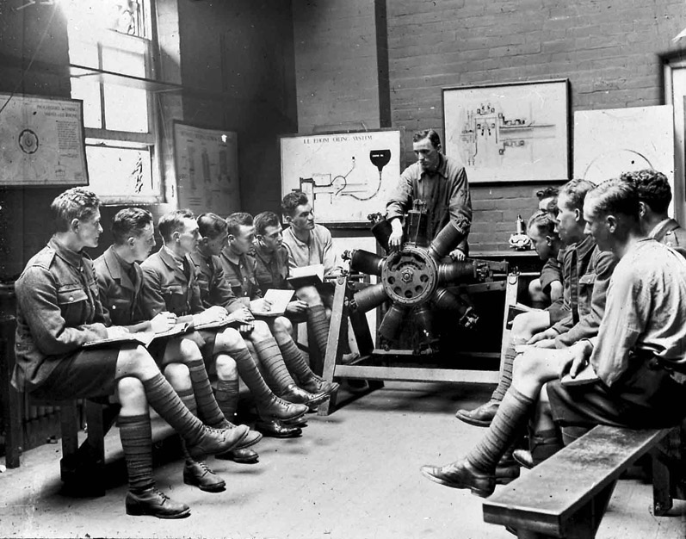
Cleeve Prior 1914 -1918
Notes:
There he would have undergone training on tactical flying, map reading, the mechanics of the aircraft and how the aero engine works as we see in this particular photograph…..next slide

Slide 36
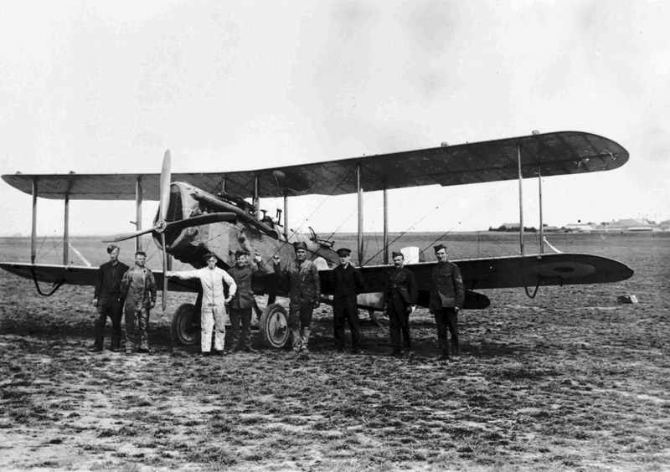
Cleeve Prior 1914 -1918
Notes:
This is the plane that he trained on which is a De Haviland DH4. Wilfred Stanley had just finished his flying training and was about to be sent home on leave before going to a front line squadron in France when he went up in a more powerful De Haviland DH 8. Aeronautical engineers did not fully comprehend the power weight ratios of aircraft at the time and the DH8 proved to be extremely unstable in the air. According to one of the officers who witnessed the event was that it simply seemed to fall out the sky from about a height of 100 feet.

Slide 37
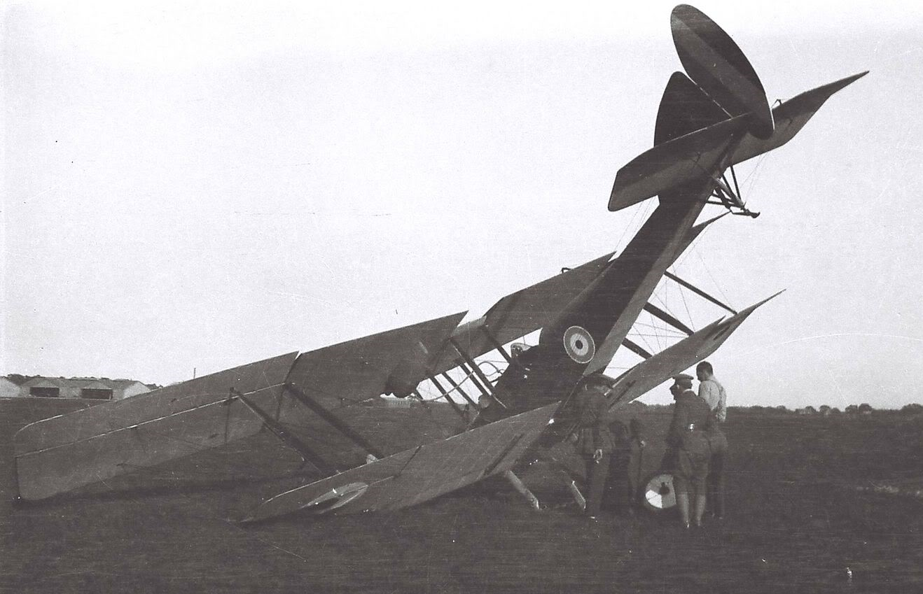
Cleeve Prior 1914 -1918
Notes:
This a picture of a crashed DH8 of which there were many and although the plane did see frontline service it was withdrawn after about two months and considered by pilots as a bit of a deathtrap. The German fighter ace the Red Baron actually managed to shoot 8 down in one day….he thought it was a terrific plane. The less powerful DH4 however remained in service till the end of the war and was considered a fine aircraft.

Slide 38
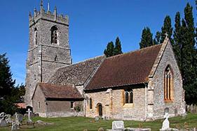
Cleeve Prior 1914 -1918
Notes:
His body was bought back from Hounslow and is buried about 70 yards from here in St Andrews Church

Slide 39
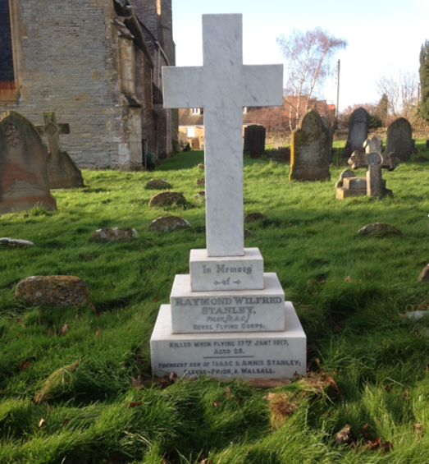
Cleeve Prior 1914 -1918
Notes:
Raymond Wilfred Stanley Died aged 26 on the 17th January 1917

Slide 40
George Brookes Born 1892 Parents were originally from Welford on Avon but had moved to Cleeve Prior by the 1911 Census Private S/No 17285 Worcs 10th Battalion
Cleeve Prior 1914 -1918
Notes:
Our 5th man is….read and he lived in Cleeve Prior

Slide 41
Cleeve Prior 1914 -1918
Notes:
George Brookes is on the far left of the picture. George enlisted in 1914 and would have gone out to France during 1915 so saw quite a bit of active service with the Worcester 10th Battalion. He was killed in an area of the Somme were the Sheffield, Barnsley and Accrington Pals Battalions were almost wiped out on the opening day of the Battle of the Somme on 1st July 1916. We can establish that he was killed on a trench raid attacking the Pusieux Trench…..next slide

Slide 42
Cleeve Prior 1914 -1918
Notes:
This is Pusieux Trench and as it was on slightly raised ground was captured, lost and recaptured several times during the war. On the night in question 11 / 12th February which the Worcester Regimental records say were successful a trench raid took place involving about 400 men. The author Henry Russell who wrote about the soldiers life after the war and was involved in the raid describes it very differently…….he states that
‘No military advantage was gained by the raid and no new trenches were occupied. The 10th Worcester’s paid a heavy price for this attack with 4 killed, 13 missing 3 officers and 39 other ranks wounded. George Brookes was one of those killed on this raid……he is buried in….next slide

Slide 43
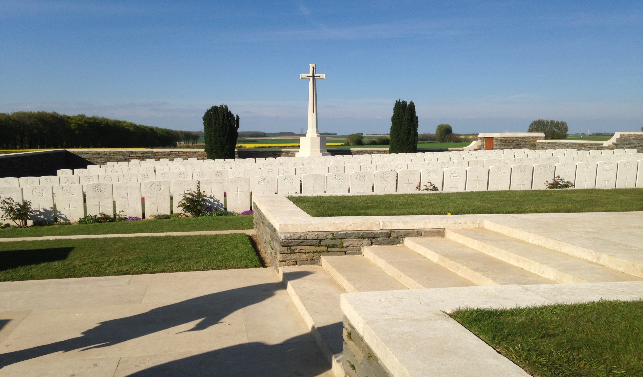
Cleeve Prior 1914 -1918
Notes:
He is buried in the Queens Cemetery at Pusieux and if ever there was a cemetery that epitomises the words out of Rupert Brookes poem ‘ That there’s some corner of a foreign field that is forever England’ then this is the place for me.

Slide 44
Cleeve Prior 1914 -1918
Notes:
His gravestone reads….17285 Private G Brookes Worcestershire Regiment 12th February 1917 He was 25 years of age

Slide 45
Ernest Cook Born 1892 Parents Thomas & Emma Cook of Cleeve Prior Lance Corporal S/No 17273 Worcs 3rd Battalion
Cleeve Prior 1914 -1918
Notes:
Our 6th man is Ernest Cook etc ……I have been unable to establish how Ernest was killed other than the 3rd Battallion was being held in the reserve at the time of his death around what the troops called the Bedford Farm area which was slightly south west of Ypres. This area remained in British hands throughout the war but could be reached by German artillery. Prior to it being called Bedford Farm it was in fact Chateau de Rosendal…..next slide

Slide 46
Cleeve Prior 1914 -1918
Notes:
Ernest Cook is the second on the left
I have been unable to establish how Ernest was killed other than the 3rd Battallion was being held in the reserve at the time of his death around what the troops called the Bedford Farm area which was slightly south west of Ypres. This area remained in British hands throughout the war but could be reached by German artillery. Prior to it being called Bedford Farm it was in fact Chateau de Rosendal…..next slide

Slide 47
Cleeve Prior 1914 -1918
Notes:
Ernest Cook’s body was never found but is commemorated on the Memorial to the Missing which is the Menin Gate Memorial in Ypres

Slide 48
Cleeve Prior 1914 -1918
Notes:
Here are recorded etc. A total of 54,389 names are recorded on the Menin Gate and at Tynecot Memorial which is probably no more that 6 miles up the road they are a further 35,000 names of British and Commonwealth troops whose bodies were simply never found. When you consider that nearly 90,000 British men have no known grave it simply reflects on the appalling violence of this conflict and the atrocious conditions in which the men had to endure. It is thought that 1 in 4 men died of drowning.

Slide 49
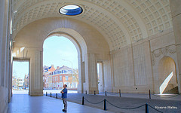
Cleeve Prior 1914 -1918
Notes:
The Menin Gate Memorial was built at Winston Churchill’s insistence and was against the wishes of the towns people of Ypres. It was designed by Sir Reginald Blomfield and was unveiled in 1927 and is a stunning piece of architecture…...next slide

Slide 50
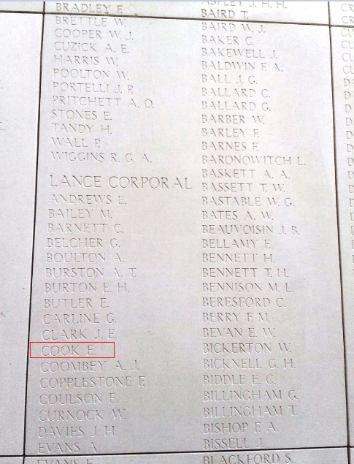
Cleeve Prior 1914 -1918
Notes:
Panel 34 and I have highlighted his name in red Lance Corporal E Cook died 11th August 1917 age 25
The trophy for the winning team in the memorial cricket is named after him

Slide 51
Albert Adams Born in 1884 Lived in Cleeve Prior & parents were from Honeybourne Company Sgt Major S/No 6473 Worcestershire 1st Battalion
Cleeve Prior 1914 -1918
Notes:
Our 7th man is…….Albert Adams was a career soldier and had also served in the latter stages of the Boer War in South Africa……his rank of Company Sgt Major is the highest rank a non commissioned soldier can achieve and would have been highly respected. We are fortunate that Btn records paint a picture of their move up to the front line where Albert Adams was to lose his life…….

Slide 52
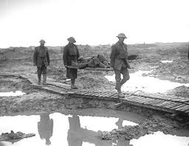
Cleeve Prior 1914 -1918
Notes:
It describes how they moved up in the first light of the morning over duckboard over the muddy morass through to ….dawn showed the front line area in its true horror……next slide

Slide 53
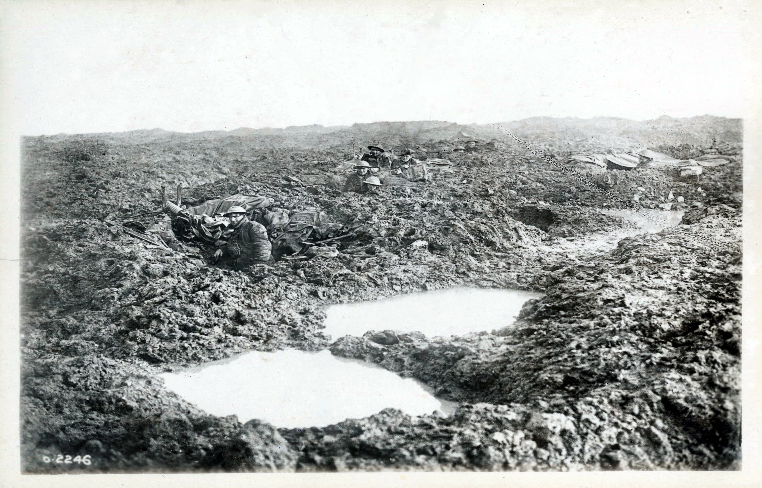
Cleeve Prior 1914 -1918
Notes:
Albert Adams was killed when the trench they were in took a direct hit from a large shell at 6.15 am…12 men were killed and 5 were missing. Missing in this sense was that the body was simply blown to pieces or was buried by mud in the aftermath of the explosion…..next slide

Slide 54
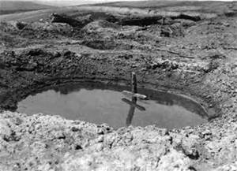
Cleeve Prior 1914 -1918
Notes:
This is the sort of crater that would have left following a large shell which would have quickly filled up with water……next slide

Slide 55
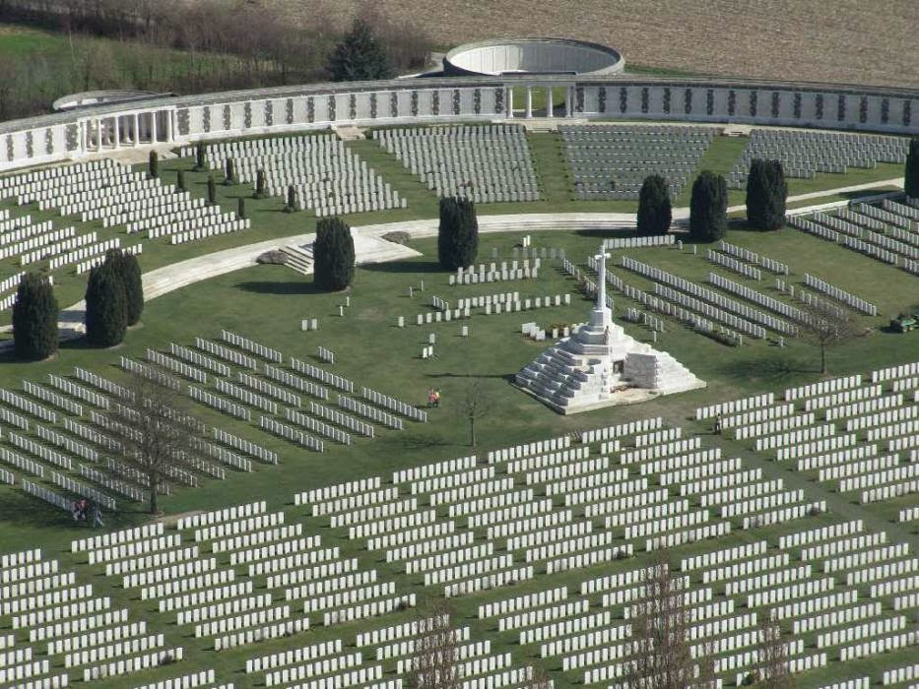
Cleeve Prior 1914 -1918
Notes:
He is commemorated here at the Tynecot Cemetery and Memorial to the Missing which is this is Britains largest war cemetery….in the foreground you see the individual graves and at the rear you see the inscription panels to the missing…..next slide

Slide 56
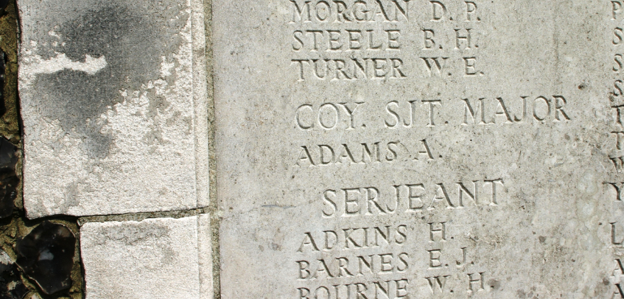
Cleeve Prior 1914 -1918
Notes:
and this is the panel with Company Sgt Major A Adams died 22nd November age 33
1917 draws to a close with the usual winter offensive shutdown but shelling continues at front lines unabated

Slide 57
1918
Cleeve Prior 1914 -1918
Notes:
1918 starts with what was known as the German Spring Offensive. Buoyed by over 1 million fresh troops from the Eastern Front due to the collapse of the Russian war effort and with the knowledge that 1.3 million fresh American troops will be arriving by the start of summer. Germany attack again on the northern section of the western fronts in what is make or break attempt to win the war.
All the ground recovered by the British and Commonwealth troops in the last 3 years of war is lost again in a matter of weeks. United States enters the War at long last and these fresh troops allows the Allies to go on the offensive again and we lose another 4 men from the village. The first of these being……next slide

Slide 58
Cecil Perkins Born 1896 Lived in Cleeve Prior Yorkshire 2nd Battalion but attached to the 21st Light Trench Mortar Battery
Cleeve Prior 1914 -1918
Notes:
Our 8th man is……..etc Cecil had sent a telegram to say that he was coming home on two weeks leave but sadly he never made it. He mortally wounded when the billet that he was staying in overnight at Calais was bombed by German Gotha bombers. Calais of course was the main embarcation port for the British war effort and saw increasing number of bombing raids during 1918 following the Spring Offensive. ….next slide

Slide 59
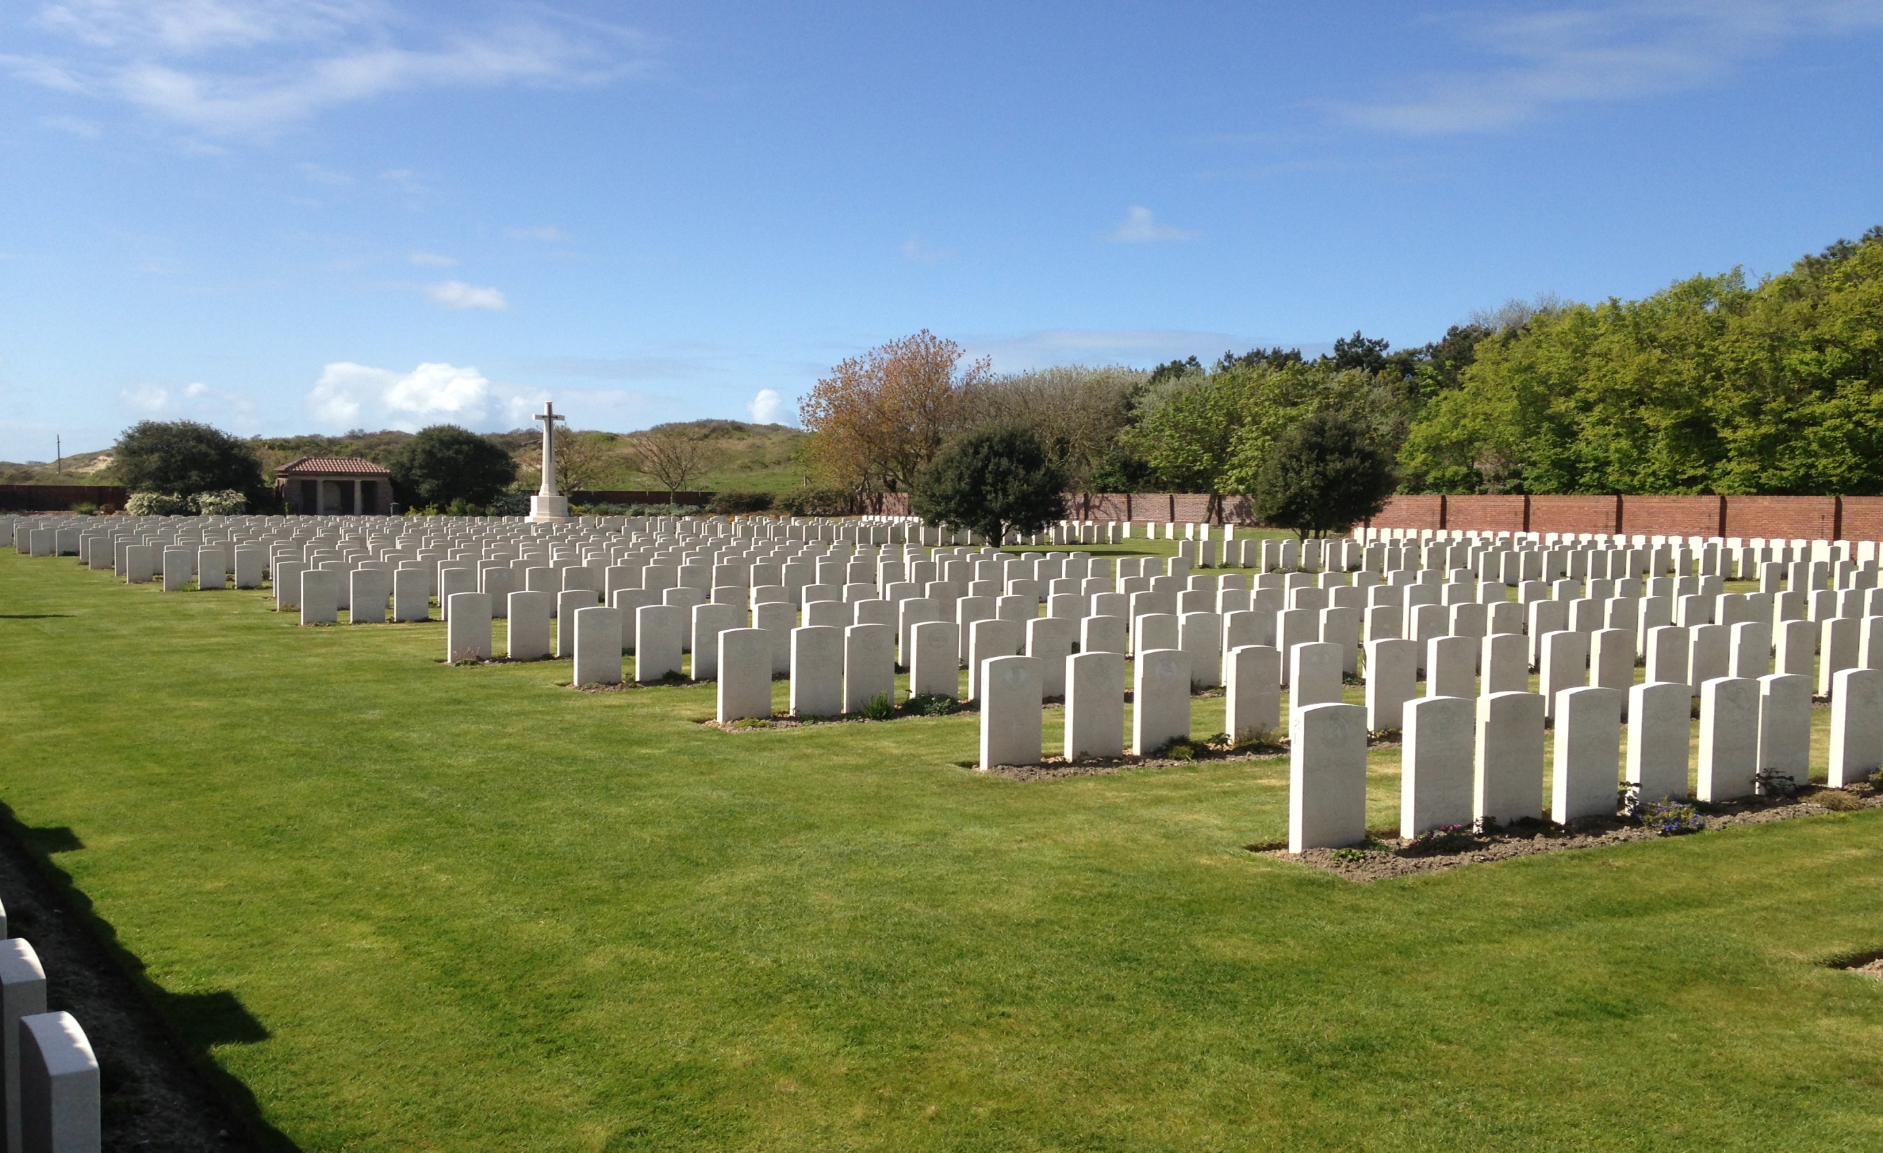
Cleeve Prior 1914 -1918
Notes:
Cecil is buried here at Les Baraques Military Cemetery in Sangatte Calais. This is a spacious cemetery and also contains the graves of about 100 or so Chinese men from the Labour Corps who had succumbed to the Spanish Flu. Behind the copse of trees you see in the picture is the you the English Channel and beyond that Good Old Blighty which sadly he never made it back to ….next slide

Slide 60
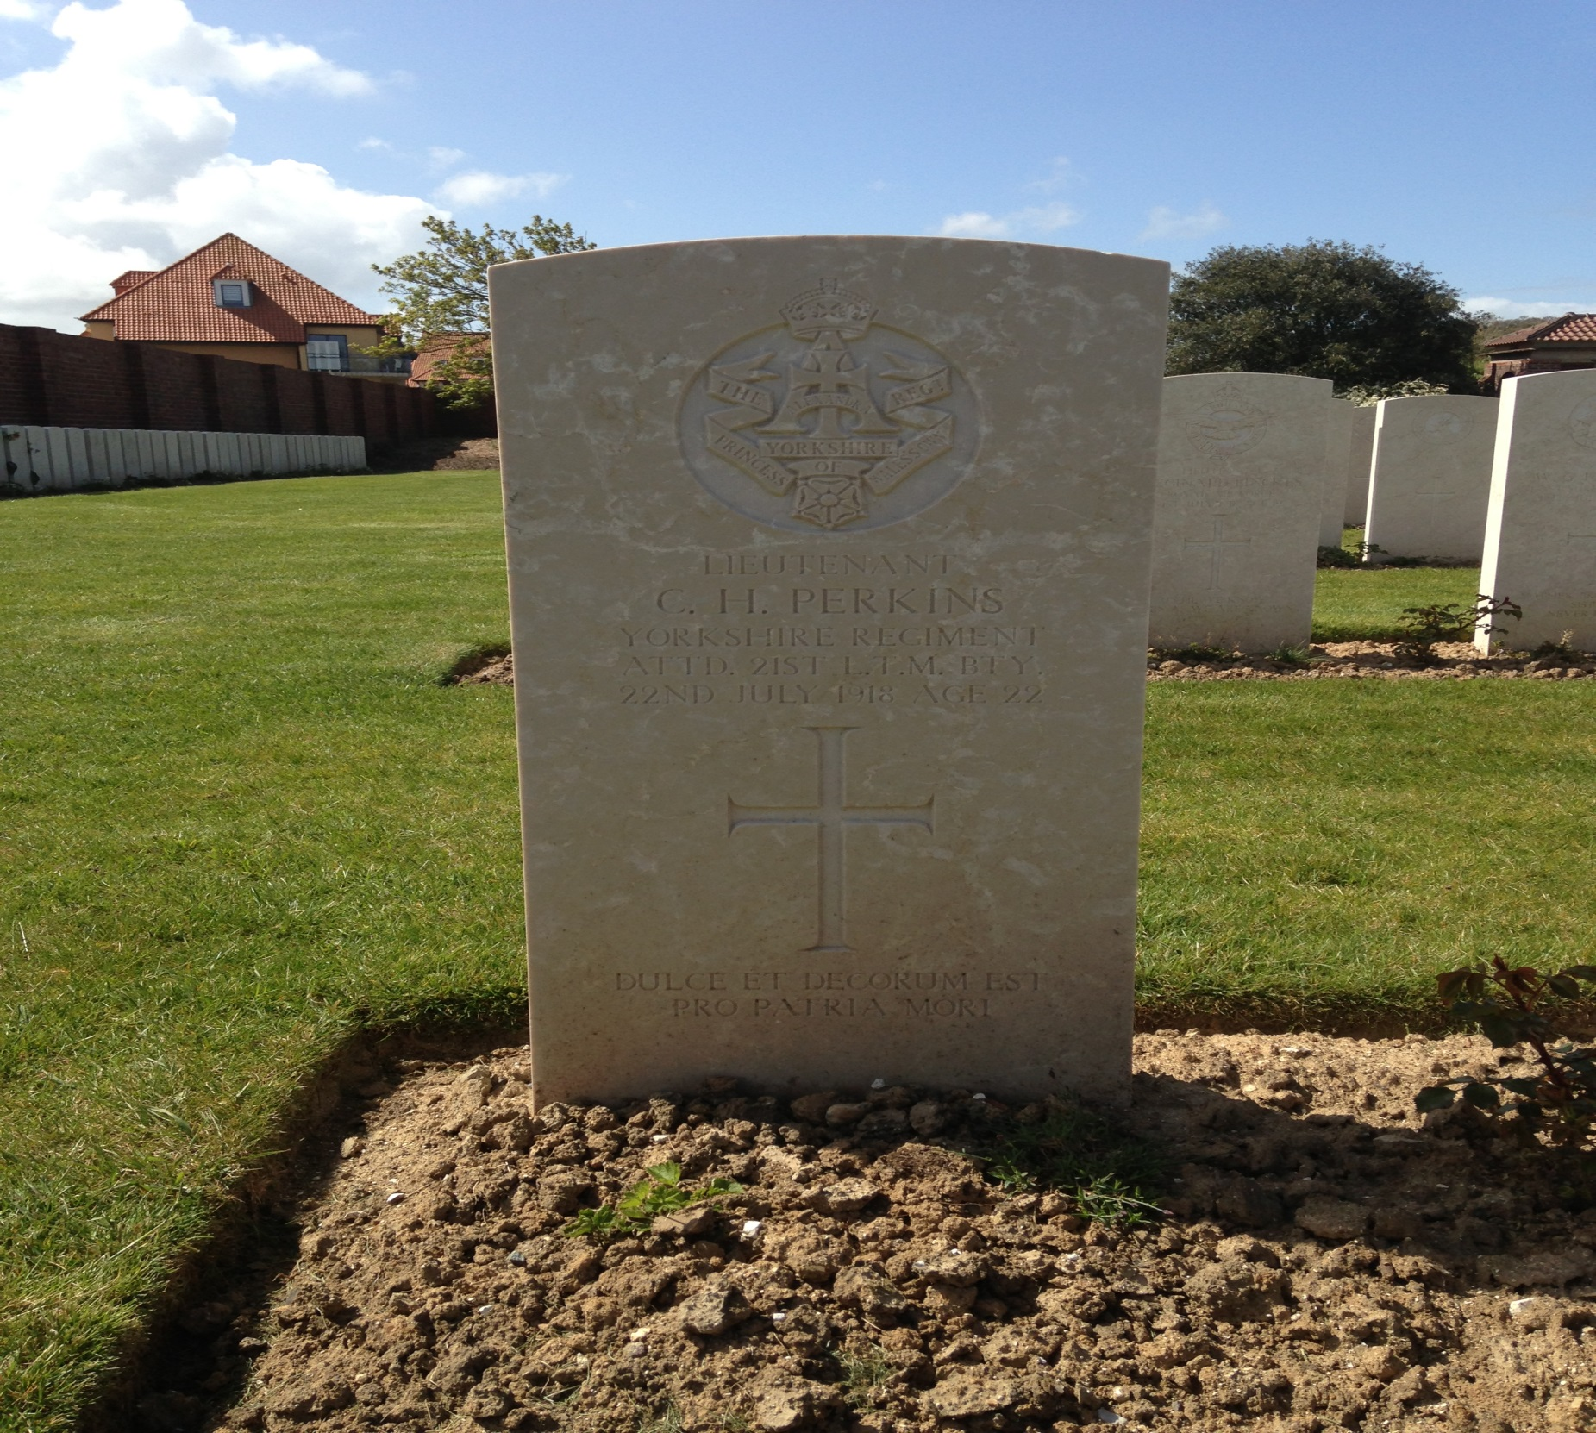
Cleeve Prior 1914 -1918
Notes:
and here is his grave which reads….. Lieutenant CH Perkins died on the 22nd July aged 22

Slide 61
George Oakey Born 1889 Lived in Cleeve Prior and his parents were Charles & Mary Oakey Grenadier Guards 3rd Battalion S/No 30290
Cleeve Prior 1914 -1918
Notes:
Our 9th man is George Oakey etc He was in the Grenadier Guards which is one of the oldest and arguably one of the finest British Regiments. The 3rd Battalion had been fighting in what was called the battle of the Canal du Nord in between Bapaume and Cambrai when he was killed …..next slide

Slide 62
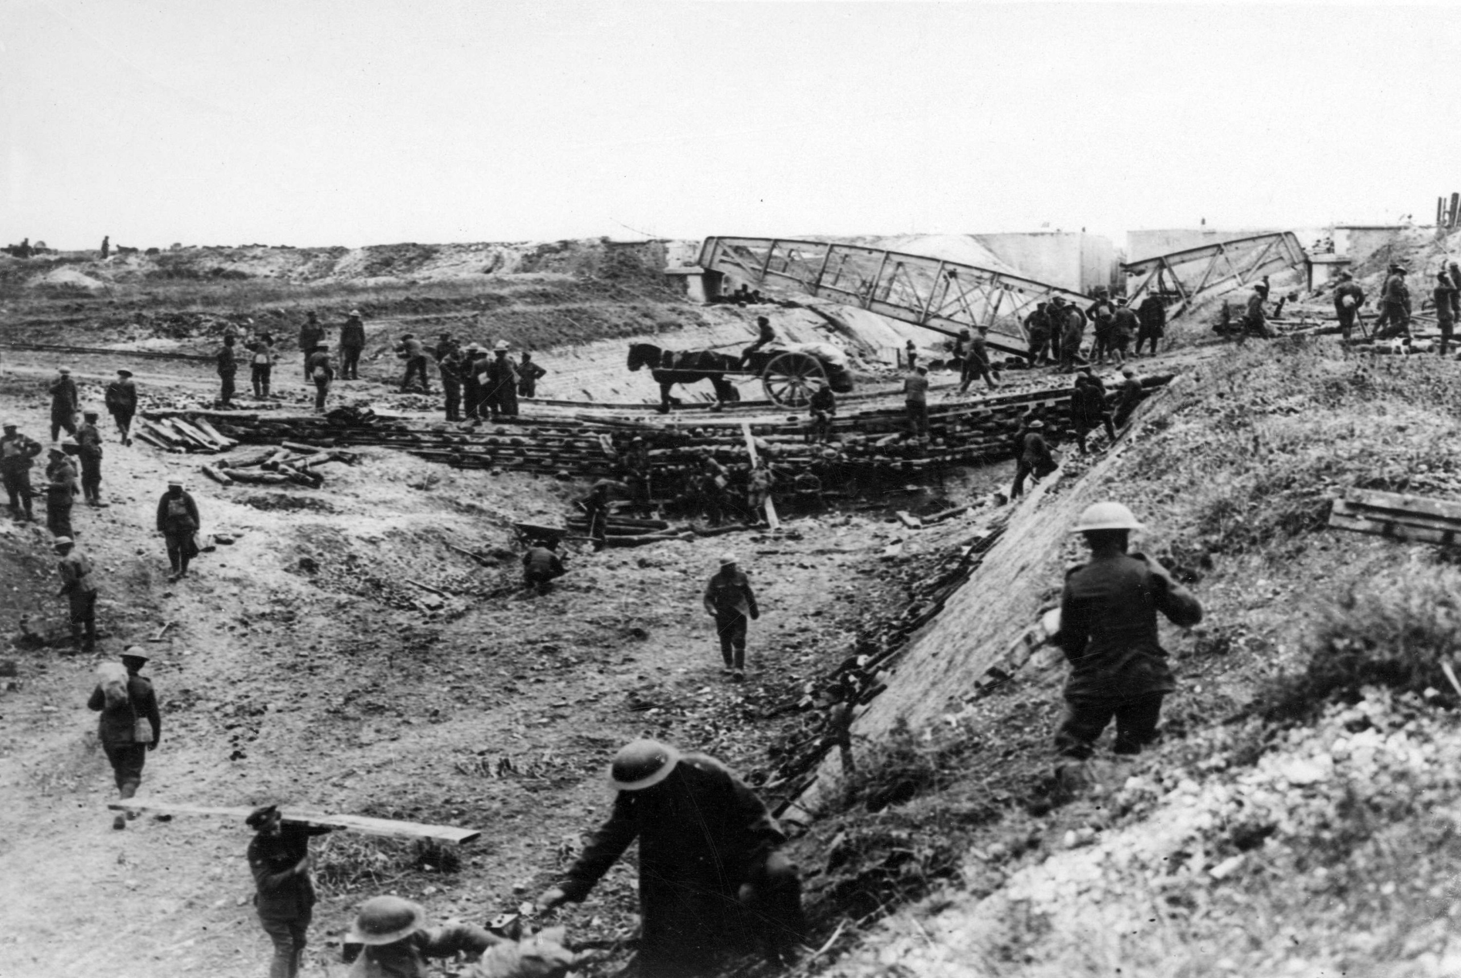
Cleeve Prior 1914 -1918
Notes:
The Canal du Nord was under construction and had been started in 1908 for the transportation of coal from the mines in the Pas de Calais region. By 1914 it was still under construction and not been filled by water………with its deep cuttings

Slide 63
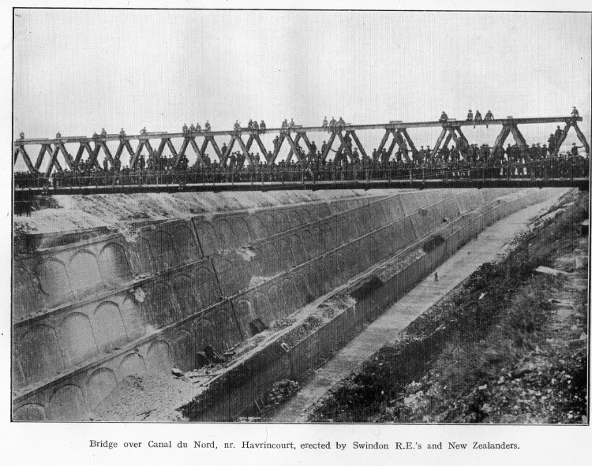
Cleeve Prior 1914 -1918
Notes:
………with its deep cuttings it proved an ideal defensive position for the Germans. The image here is from a postcard presumably after the bridge had just been built by the Swindon RE’s and NZ’s George Oakey was in the front line at a village called Lagnicourt – Marcel when according to btn diary records ‘ At 9am a heavy barrage descended on the whole of the battalion front line and all communication wires were cut. Casualties were 3 killed and 6 wounded. Sadly George Oakey was one of those killed…..next slide

Slide 64
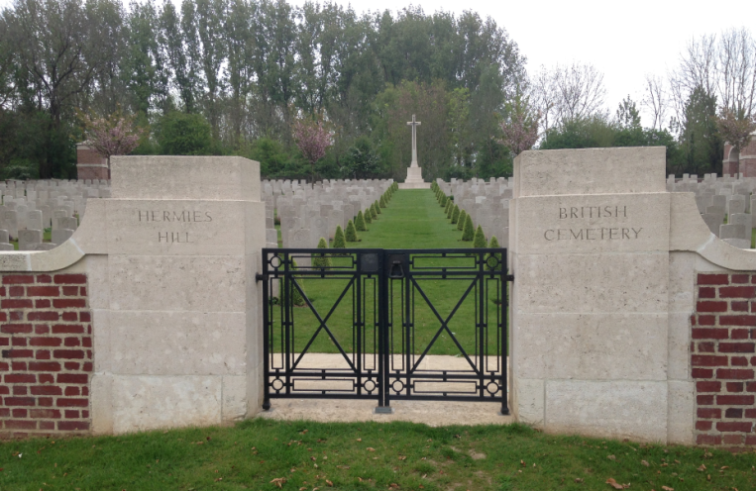
Cleeve Prior 1914 -1918
Notes:
He is buried here at the Hermies Hill Cemetery in the village of Hermies which is about a mile south on Lagnicourt – Marcel

Slide 65
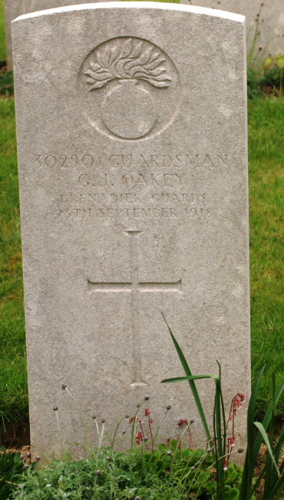
Cleeve Prior 1914 -1918
Notes:
His Gravestone reads Private 30290 G.J. Oakey Grenadier Guards Died 25th September 2018 Aged 29 and is the 9th of our Cleeve Prior men

Slide 66
Edwin Jesse Nicholls Born 1889 Parents Joseph & Emily Nicholls of Cleeve Prior 2nd Lieutenant Worcs 1st Battalion Awarded Military Cross
Cleeve Prior 1914 -1918
Notes:
Our 10th man is …..He was killed in during the retaking of the city of Douai ( DWE ) just 23 days before the armistice was signed. He won his Military Cross which was awarded to him posthumously and this is his citation which appeared in the London Gazzette…..next slide

Slide 67
Cleeve Prior 1914 -1918
2nd Lt. Edwin Jesse Nicholls, 1st Bn., Worcester Regiment.
Whilst in command of a raiding party at Oppy, on the night of 15th-16th September, 1918, he showed marked gallantry and zeal. His party cleared the hostile positions to a depth of over 1,000 yards. Although not successful in obtaining a prisoner, as the enemy fled from his forward posts, he obtained valuable information of the enemy's sector and his methods of defence. He remained in the hostile line for over an hour.
Later in the night he was ordered to hold and consolidate the area taken. He went forward with the selected .garrison, but was forced to withdraw on account of strong hostile parties being again in occupation of the hostile positions.
Notes:
The Citation in the London Gazette for his posthumous award in 1919 of the Military Cross reads as follows:- on separate sheet together with Btn diary records
Edwin Nicholls was killed during the retaking of the city of Douai which had been in German hands since the start of the war just 23 days before the armistice was signed.

Slide 68
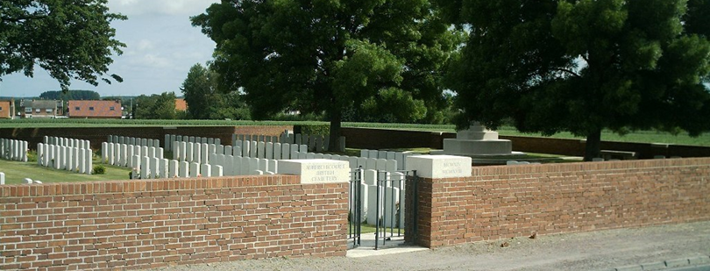
Cleeve Prior 1914 -1918
Auberchicourt Cemetery
Notes:
Edwin Nicholls is buried in the Auberchicourt cemetery near Cambrai

Slide 69
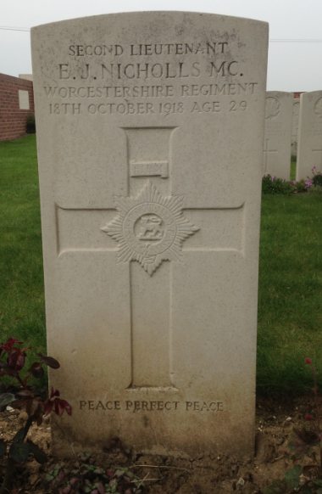
Cleeve Prior 1914 -1918
Notes:
His gravestone reads Second Lieutenant E.J. Nicholls MC Worcestershire Regiment 18th October 1918 Aged 29

Slide 70
Arthur Gordon Sisam Born 1890 Parents Thomas & Mary Jane Sisam of Cleeve Prior South Wales Borderers 6th Battalion S/No 16791
Cleeve Prior 1914 -1918
Notes:
Our 11th man is Arthur Sisam had been born in the village but moved down to Newport in South Wales in 1912 to join his elder brother Jack Sisam working on a large market garden. He volunteered in September 1914 before going over to France a year later landing on the 25th September 1915

Slide 71
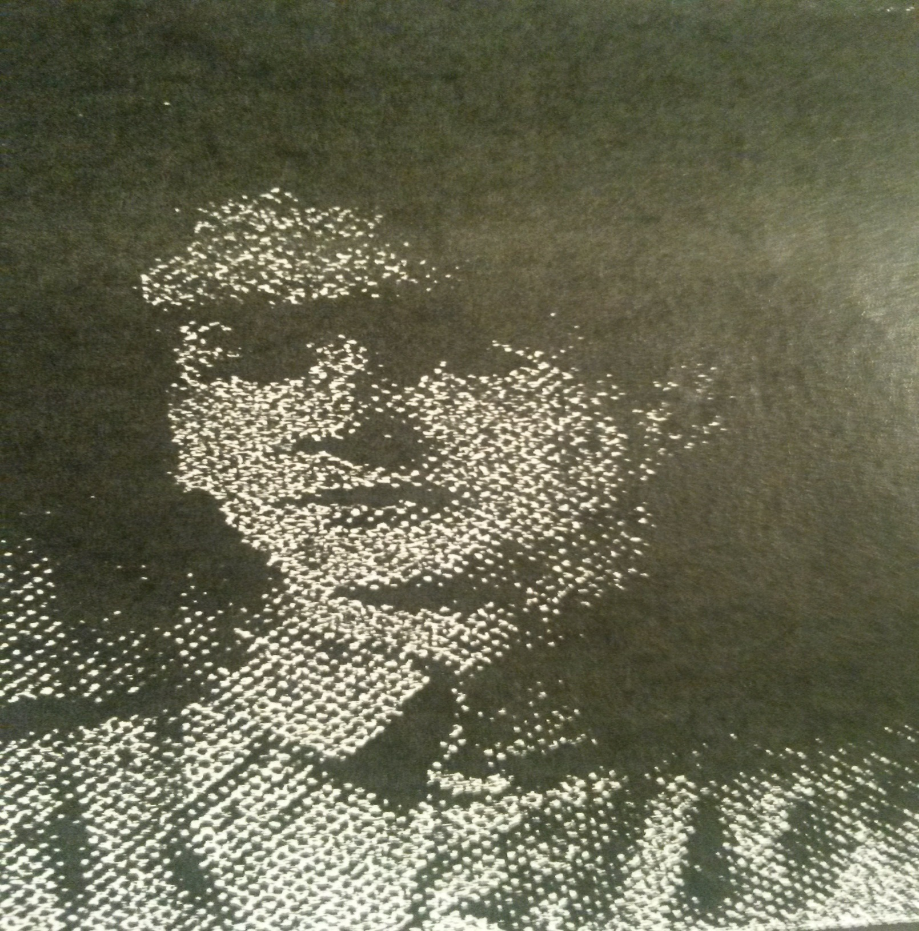
Cleeve Prior 1914 -1918
Notes:
This is a picture taken from a photocopy of the Evesham Journal just which reported his death and gave this brief account of his service and I quote ‘ Going to France in 1915 he has been in all the fighting with his Battalion, never been wounded or sick but twice home on service leave. He left his Battalion on October 25th for fourteen days leave, was taken ill on arrival at London and died from pneumonia.’
He died in the King Georges Military Hospital in London 6 days before his leave ended and 9 days before the war ended.

Slide 72
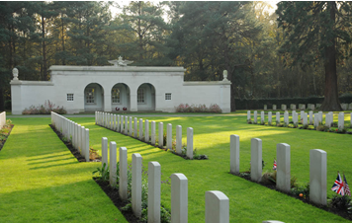
Cleeve Prior 1914 -1918
Brookwood Military Cemetery.
Woking
England
Notes:
He is buried in the Brookwood Military Cemetery near Camberley in Surrey in Plot 12 Row D9

Slide 73
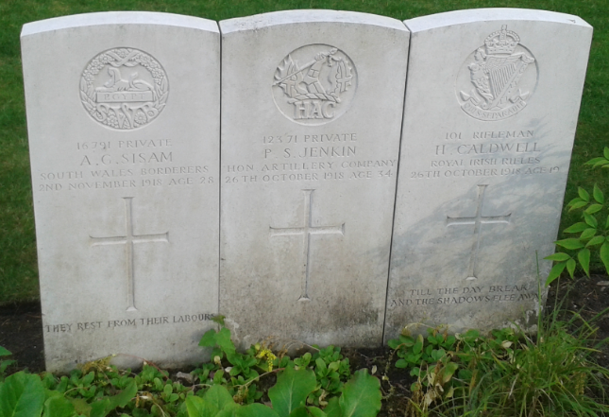
Cleeve Prior 1914 -1918
Notes:
Arthur Sisam’s grave is on the far left and reads 16791 Private A.G.Sisam South Wales Borderers 2nd November 1918 Age 28
That covers the 11 men on the boards from the First World War who sacrificed their lives for King & Country but before I finish could I ask you to reflect for a moment on the next slide

